Slide 1
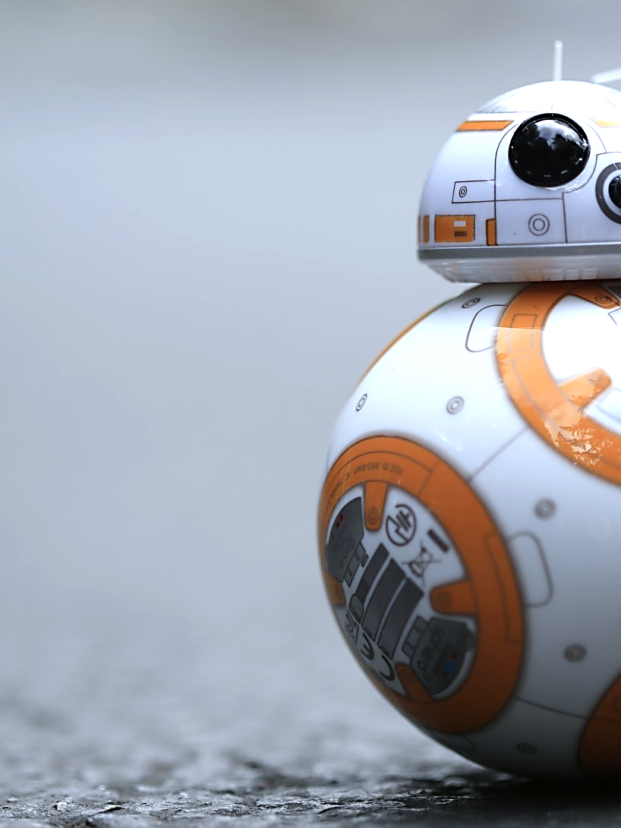


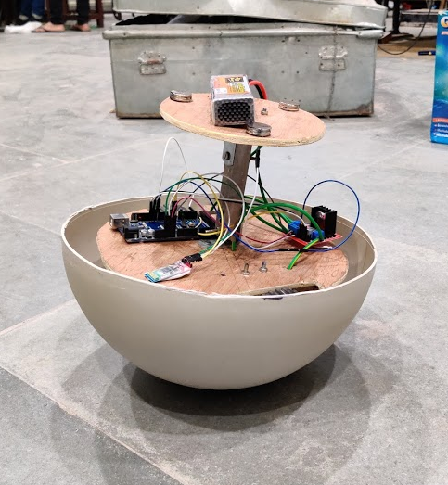
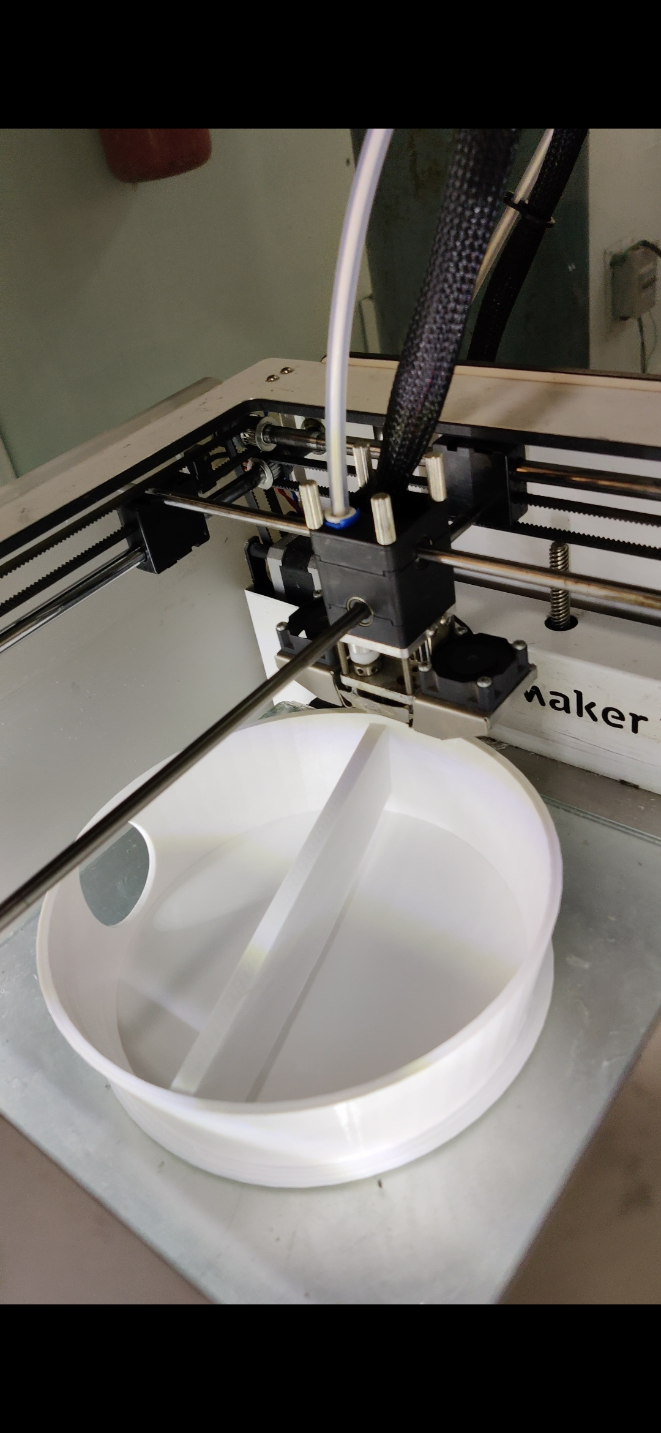
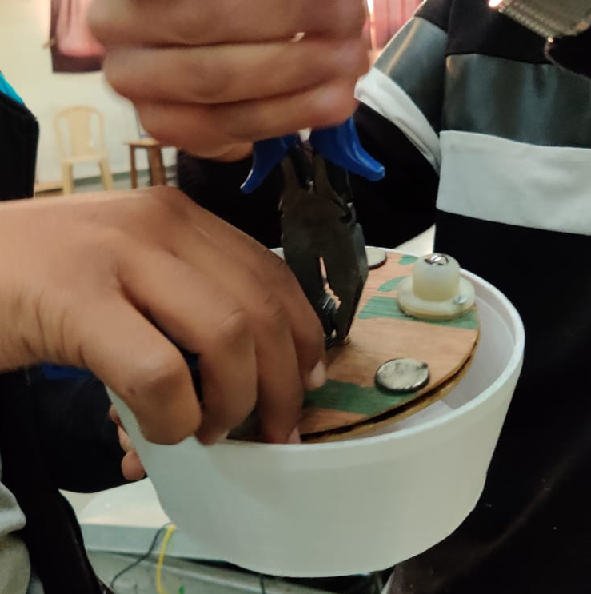
Star Wars BB9
Models and Robotics Section, IITR
The droid should replicate BB-8 from the Star Wars franchise complete with a rotating body but a stationary head.
The movement of the droid can be controlled by a companion app.
The body can rotate freely and can be moved forward or backward using the app
The head is stabilised by using strong Neodymium magnets and ball casters
Made by:
Kritin Agrawal
Kush Bansal
Ruthik Jadhav
Sachin Agrawal
Vaibhav Aggarwal
Mentored by:
Shubham Goyal
Simran Bajoliya

